Slide 1
Circular Motion

Slide 2

Welcome to this Smart Lesson on circular motion!
After completing this Smart Lesson you will be able to:
Describe circular motion.
Define period, frequency, and centripetal acceleration.
Perform calculations of circular motion.

Slide 3
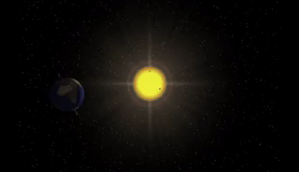
Circular Motion
Circular motion is repetitive. When moving in a circle, an object comes back around to the start of the circle and repeats the motion all over again.

Slide 4
One movement around the circle is called a rotation or revolution. The time it takes for one rotation is the period (T). The period is a measure of time, so the unit of the period is the second (s). This traffic cone rotates once every 1.8 s. Therefore, T=1.8 s.

Slide 5
The frequency of rotation of an object is how many times per second the object completes a rotation. The symbol for frequency is f, and the unit of frequency is the hertz (Hz). One hertz is equivalent to one cycle per second (s−1). This traffic cone rotates 0.55 cycles per second. Therefore, f=0.55 Hz.

Slide 6
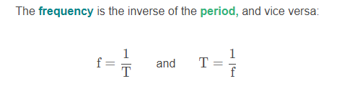
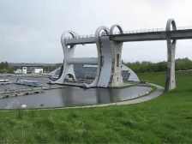

Slide 7
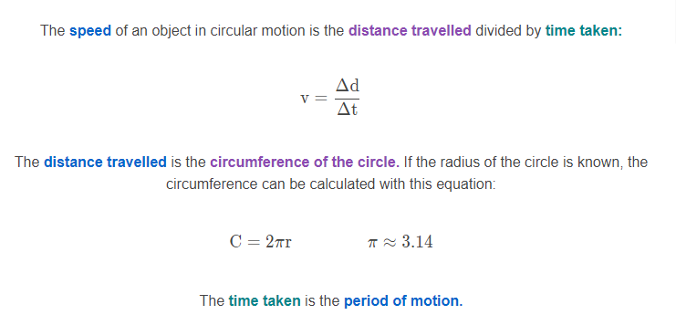

Slide 8
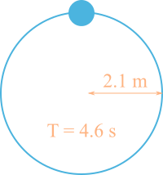
Example
This object travels in circular motion with a radius of 2.1 m and period 4.6 s.
How fast is the object travelling?

Slide 9
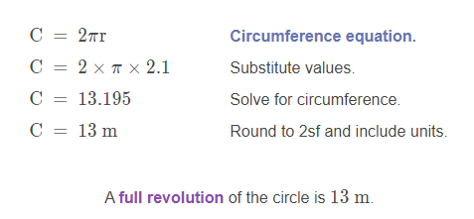
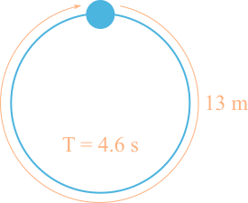
Solution
This object travels in circular motion with radius 2.1 m and period 4.6 s.
Before we calculate the speed we need to calculate the distance travelled, which we do by calculating the circumference of the circle:

Slide 10
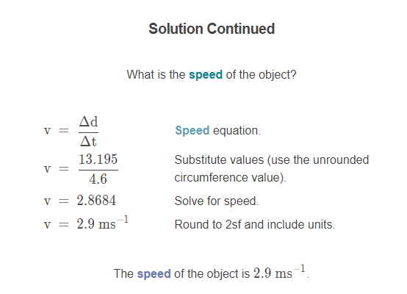
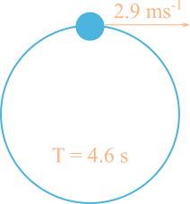

Slide 11
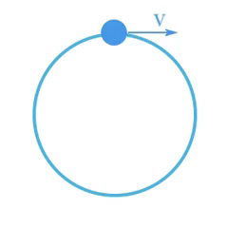
Centripetal Acceleration
An object travelling in circular motion isn't changing speed, but it is changing direction at a constant rate. The velocity of the object is changing.
This means the velocity of the object is changing and therefore the object is accelerating!

Slide 12
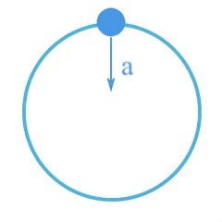
The acceleration of the object points toward the centre of the circle.

Slide 13
If the object stopped accelerating toward the centre, the direction of motion of the object would stop changing, and the object would continue along its instantaneous velocity vector.

Slide 14
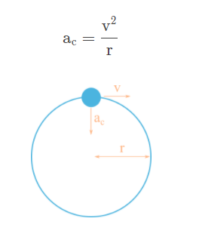
Centripetal Acceleration Calculations
The relationship between speed (v), radius (r), and centripetal acceleration (ac​), can be expressed with the following equation:

Slide 15
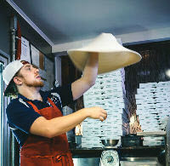
Example
A pizza base of radius 0.15 m must be spun at 1.9 ms−1 to properly stretch. What is the centripetal acceleration of the pizza base?

Slide 16
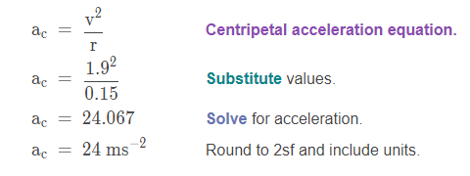
Solution
A pizza base of radius 0.15 m must be spun at 1.9 ms−1 to properly stretch.
What is the centripetal acceleration of the pizza base?

Slide 17
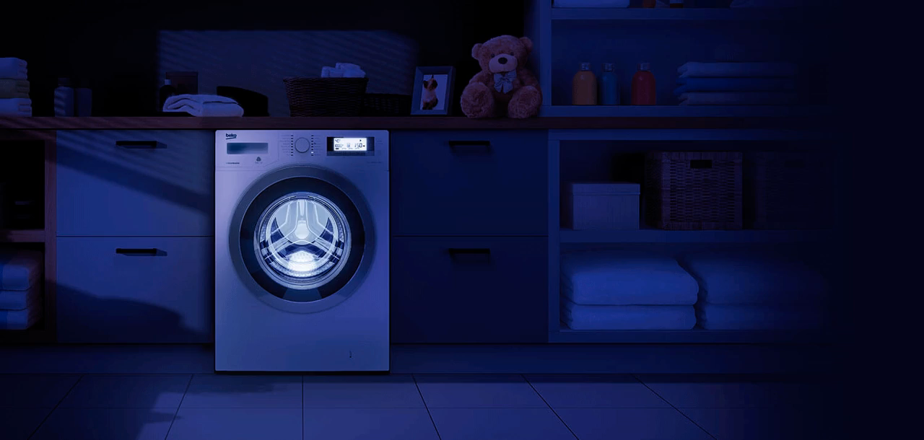
Example
An ordinary washing machine has a circumference of about 1.5 m and spins at a speed of 37 ms−1.
What is the centripetal acceleration experienced by your clothing when it's in the spinning washing machine?

Slide 18
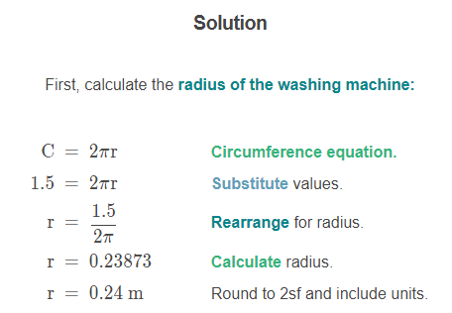

Slide 19
